Slide 1
EMPOWERING ELs FOR A SUCCESSFUL TOMORROW USING TEXT DEPENDENT QUESTIONS
TDQ
Jayme Adelson-Goldstein, Lighthearted Learning
Lori Howard, CASAS
Sylvia Ramirez, MiraCosta College
Notes:
10:45 START

Slide 2
Introductions
Lori
Jayme
Sylvia
HERE’S OUR WIKI
http://ccrstdq.pbworks.com
Notes:
Find out who we have in the room—show of hands for teachers

Slide 3
Introductions
I am a….
I am an….
OTHER
EQUALLY IMPORTANT PERSON
TEACHER
EDUCATOR
ADMINISTRATOR
TEACHER
COORDINATOR
Notes:
Find out who we have in the room—show of hands for teachers

Slide 4
Introductions
Very familiar
Familiar
Somewhat
Familiar
CCR what?
Notes:
Think about adding ELPS slide – How familiar are you with the three instructional shifts associated with college and career readiness- List shifts, then focus?

Slide 5
Goals
After this session, you’ll be able to:
1. Help learners navigate level-appropriate complex text and its related academic language;
2. Identify, adapt and create strategic TDQs
Notes:
1. describe the impact of the three instructional shifts on their programs and materials
2. help learners navigate level-appropriate complex texts and its related academic language
3. identify and then adapt or create strategic text-dependent questions to deepen learners’ knowledge of text and help them demonstrate high-level thinking.

Slide 6
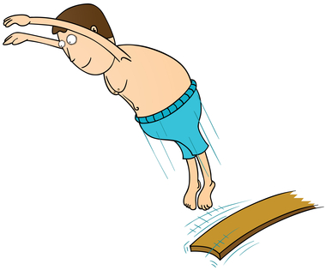
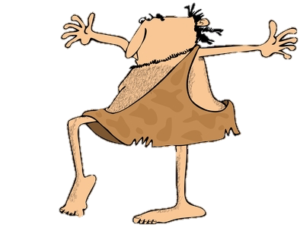
A WORD ABOUT….
THE DIVE
THE DIP
Goals
Notes:
And just a quick word about dip and the dive–we’re a passionate trio and if we had our way, we’d dive deeply into all these concepts with you. But there’s this thing called lunch that you may want to engage in—so you will see these icons indicating when we have to“dip” into certain topics and we will dive. (We’ll definitely take a deeper dive into text dependent questions)

Slide 7
DIVING INTO…
TDQ

Slide 8
What do TDQs require learners to do?
Text-dependent questions require learners to:
• identify the text as the “expert” in the room
(not learners’own personal experience or opinion).
• probe the specifics of the text.
• focus on the language and mechanics of the text itself.
TEXT
Adapted from College and Career Readiness Standards Implementation Institute Training Materials by S. Ramirez and L. Howard.

Slide 9
FOCUSING ON THE TEXT
Adapted from College and Career Readiness Standards Implementation Institute Training Materials by S. Ramirez and L. Howard.

Slide 10
FOCUSING ON THE TEXT
Not Text-Dependent
Text-Dependent
This newspaper article discusses a recent earthquake. Describe a time when you or someone you know experienced an earthquake.
In this newspaper article about the earthquake, how did the reporter describe Mrs. McDaniel’s reaction to the earthquake?
Adapted from College and Career Readiness Standards Implementation Institute Training Materials by S. Ramirez and L. Howard.

Slide 11
FOCUSING ON THE TEXT

Slide 12
FOCUSING ON THE TEXT
Not Text-Dependent
Text-Dependent
Look at the photo. What is the young woman thinking about?
Look at the photo. What is the woman thinking about? How do you know? Use the information from the photo.

Slide 13
PROGRESSION OF TEXT DEPENDENT QUESTIONS
Whole
Across texts
Entire text
Segments
Paragraph
Sentence
Word
Part

Slide 14
DIVING INTO…
TEXT COMPLEXITY & TDQ

Slide 15
DIVING INTO THE CONCEPTS
FORM GROUPS OF FOUR.
THE TASK: TEACH EACH OTHER ABOUT COMPLEX TEXT, TDQ & ACADEMIC LANGUAGE
THE APPROACH: PAIRED READING
Notes:
TASK: JIGSAW READING
PURPOSE INTRODUCE OR REVIEW HOW THE CCRS SHIFTS ARE INTEGRATED INTO ESL INSTRUCTION
THE APPROACH: ACTIVE, SELF-DIRECTED LEARING AND TEACHING TO ACCOMODATE DIFFERENT LEVELS OF BACKGROUND KNOWLEDGE – AND IT WILL COME AS NO SURPRISE THAT THE TASK ITSELF MODELS SHIFT INTEGRATION
AS FOR THE OUTCOME...WE ARE HOPEFUL YOU WILL BE ABLE TO APPLY WHAT YOU’VE LEARNED TO TOWARDS THE DEVELOPMENT OF INSTRUCTIONAL MATERIALS.

Slide 16
DIVING INTO THE CONCEPTS
READING A
Depend on the Text!
READING B Using Complex Texts to Develop Complex Language & Literacy

Slide 17
DIVING INTO THE CONCEPTS
PAIR A READING A
PAIR B READING B
WORK WITH A PARTNER
READING A
Depend on the Text!
READING B
Using Complex Texts to Develop Complex Language & Literacy
Notes:
4 MIN TO INTRO CONCEPT, FORM A GROUP WITH 5 COLLEAGUES.
PAIR UP
NUMBER HEADS 1-2 COMPLEXITY, 3-4 EVIDENCE, 5-6 KNOWLEDGE
SCAN THE PAPER TO SEE THESE HEADINGS—
SHOW THEM WHAT THEY’LL BE REPORTING ON—
SHOW THEM TEAR OFF SHEET
READ (TIME LIMIT)
WITH YOUR PARTNER TO CONFIRM YOUR UNDERSTANDING OF THE ITEMS YOU’LL BE REPORTING BACK ON
(DETERMINE
(7 MIN)
REJOIN HOME TEAM, AND ROUND ROBIN RESPONSES TO QUESTIONS 1 AND 2 – WHAT IS IT? WHY DO IT? ONE THING TEACHER’S DO/SS DO EACH PAIR GETS 2 MIN TO ANSWER THE QUESTION, 3 MIN FOR EACH RR- (9 MIN )
WE ARE AT 20– 5 MIN TO TALK ABOUT WHAT MATERIALS WRITERS DO
USING A T-CHART WITH TEACHER “DO” ITEMS ON LEFT, OPEN SPACE FOR MATERIALS WRITERS ON RIGHT.
S/L/J REPORT BACK BASED ON CHART…(possible take photos of chart or the group)

Slide 18
DIVING INTO THE CONCEPTS
• READ YOUR “TEXT”
• ANSWER THE QUESTIONS
• CONFER WITH YOUR PARTNER
DONE
5 MIN

Slide 19
DIVING INTO THE SHIFTS
• TEACH YOUR TEAM USING THE QUESTIONS FOR YOUR TEXT AS A GUIDE
• LISTEN CAREFULLY TO YOUR COLLEAGUES AS THEY TEACH.
DONE
2 MIN
PAIR A

Slide 20
DIVING INTO THE SHIFTS
• TEACH YOUR TEAM USING THE QUESTIONS FOR YOUR TEXT AS A GUIDE
• LISTEN CAREFULLY TO YOUR COLLEAGUES AS THEY TEACH.
1 MIN
DONE!
2 MIN
PAIR B

Slide 21
THINK ABOUT WHAT YOU HEARD
Based on what you’ve learned so far, why do you think we gave you these texts to read in this workshop?

Slide 22
WHAT LEARNERS DO:
DIVING INTO THE CONCEPTS
QUESTION
STRUGGLE
DISCUSS
SUCCEED
Notes:
DID YOU STRUGGLE AT ALL?

Slide 23
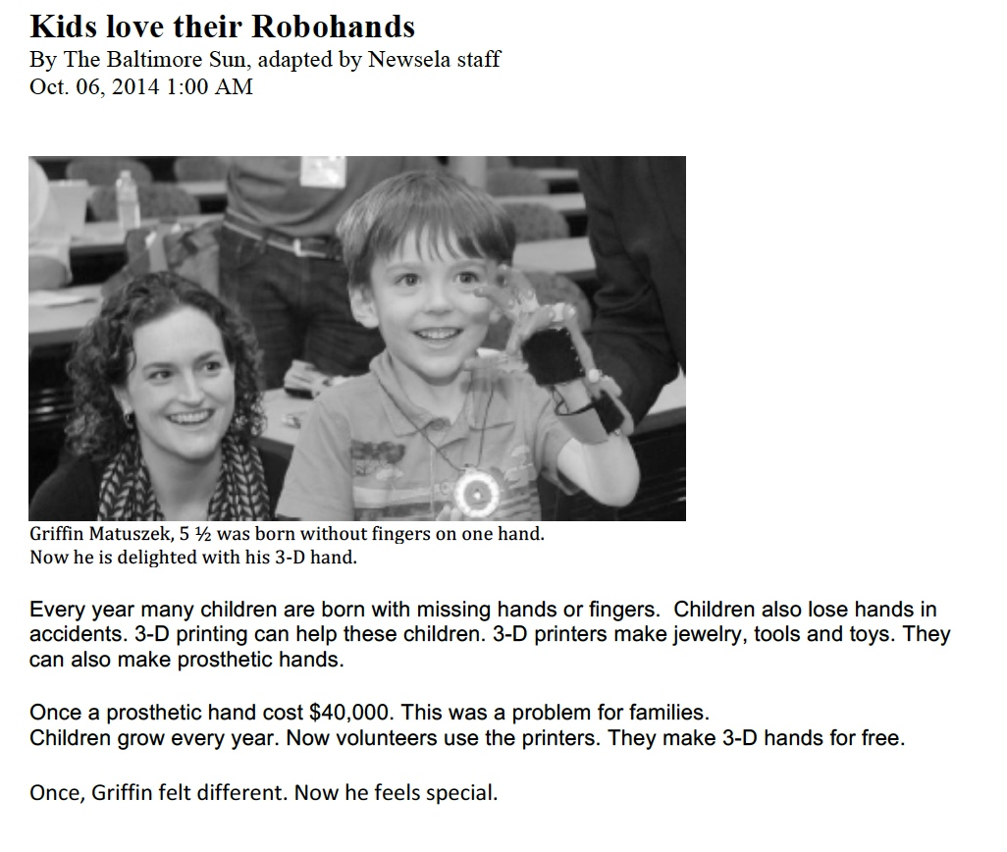
ONE OF THE TEXTS WE’LL BE WORKING WITH
PAGE 3
Notes:
DIRECT THEM TO THIS IN THEIR HANDOUT (P.4)

Slide 24
THINK
What do I want learners to get from this text?
PREPARE
What key details, vocabulary, text features, etc. will bolster
their understanding?
annotate
the text
Notes:
What do WE need to do to prepare to help our learners work with text complexity.
I’d like to do a mini-demo with a high beginning text to model how my ‘thinking with a pencil” may help students to feel more comfortable “focusing on a text” I need to
THINK about what I want my students to get from the text
PREPARE by determining essential idea(s) key details and vocabulary I want my students to understand
And then annotate the text

Slide 25
THINKING AND READING (Thinking Notes)
VOCABULARY
✔
IMPORTANT POINT/KEY DETAIL
VOCABULARY
INTERESTING
UNCLEAR, NEED HELP
MAIN IDEA
word
!
?
Notes:
And I’m going to use these thinking notes to help me remember my questions/comments. I’ll also teach them to my students so they can read with a pencil too
Problem sometimes with just highlighting is some people (like me) over highlight, and then they are practically rereading the whole text to locate key information.

Slide 26
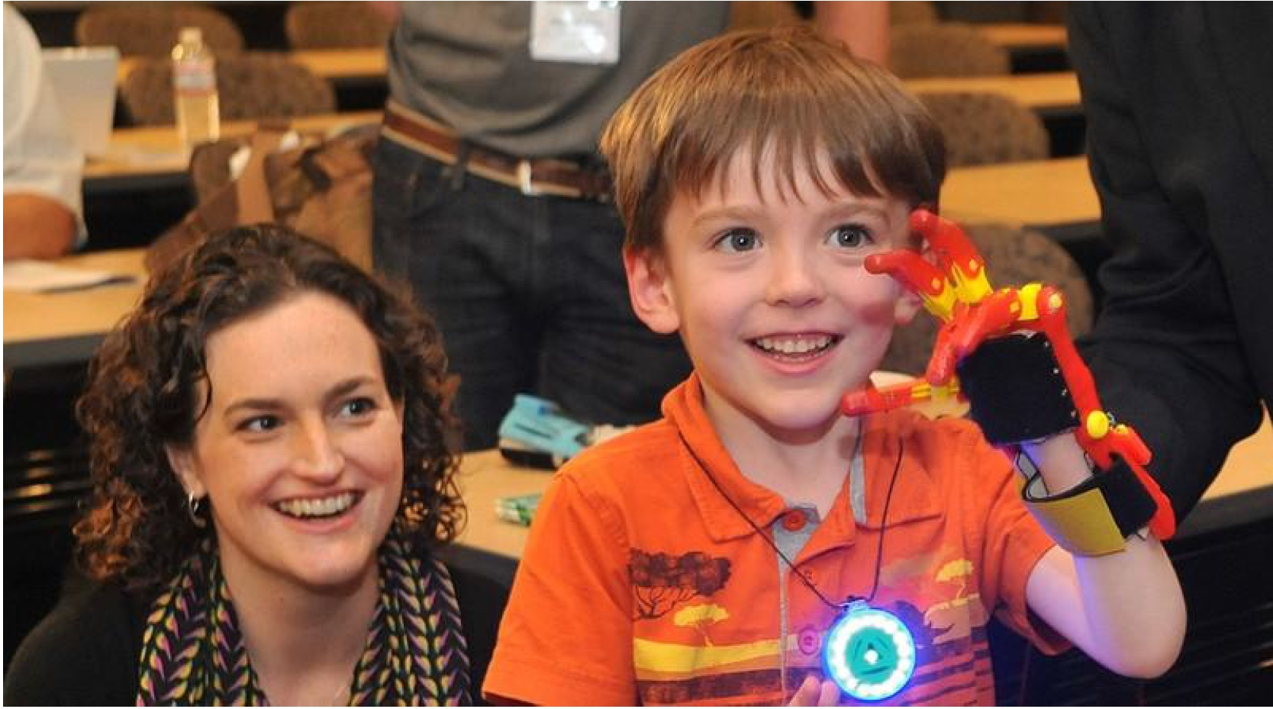
Kids love their Robohands
By The Baltimore Sun, adapted by Newsela staff
Oct. 06, 2014 1:00 AM
Griffin Matuszek, 5 ½ was born without fingers on one hand. Now he is delighted with his 3-D hand.

Slide 27
Every year many children are born with missing hands or fingers. Children also lose hands in accidents. 3-D printing can help these children. 3-D printers make jewelry, tools and toys. They can also make prosthetic hands.
Once a prosthetic hand cost $40,000. This was a problem for families.
Children grow every year. Now volunteers use the printers. They make 3-D hands for free.
Once, Griffin felt different. Now he feels special.
Notes:
DIRECT THEM TO THIS IN THEIR HANDOUT (P.4)

Slide 28
YOUR TURN: SELECT A TEXT
• Work with your partner and choose one of the six texts.
A
A
A
B
C
D
PAGE
4 BEG LITERACY
5 LOW BEGINNING
6 HIGH BEGINNING
PAGE 7
PAGE 8
PAGE 9
Notes:
Sylvia – give them a minute to select their text.

Slide 29
YOUR TURN: ANNOTATE
DONE!
4 MIN
Read your article.
Look for key vocabulary you would need to pre-teach.
Look for vocabulary you would want learners to learn within the reading.
Look at what your partner did.
word
Notes:
Give them a minute to select and read their text.

Slide 30
HOW DID IT GO?

Slide 31
THINKING AND READING (Thinking Notes)
✔
IMPORTANT POINT/KEY DETAIL
VOCABULARY
INTERESTING
UNCLEAR, NEED HELP
MAIN IDEA
word
!
?
Notes:
And I’m going to use these thinking notes to help me remember my questions/comments. I’ll also teach them to my students so they can read with a pencil too
Problem sometimes with just highlighting is some people (like me) over highlight, and then they are practically rereading the whole text to locate key information.

Slide 32
Now that we’ve had a chance to dip into the text
It’s time for more TDQ!!

Slide 33
PROGRESSION OF TEXT DEPENDENT QUESTIONS
Whole
Across texts
Entire text
Segments
Paragraph
Sentence
Word
Part

Slide 34
GENERAL UNDERSTANDING
What is the “gist” of the text? What did the author say?
Scaffolding for ESL
Look at the text. Underline the main idea. Retell the main idea in your own words.
Notes:
What is the main idea/theme of text?
Look at the text. Underline the main idea. Retell the main idea in your own words.
What does the author want the reader to understand?

Slide 35
KEY DETAILS
What are the supporting details for the main ideas?
Ask who, what, where, when, why or how questions.
Scaffolding for ESL
What is the most important detail in paragraph ____?
Notes:
What is the most important detail in paragraph ____?
Which details support the main idea?
Explain why ______ happened? How do you know?

Slide 36
VOCABULARY
What words are key to understanding the main idea and key details?
Focus on academic words, word families, and words that are abstract.
Scaffolding at different levels
What does ____ mean in the article? How do you know?
What context clues tell you what ______means?
Notes:
What does ______ as it is used in the text.

Slide 37
INFERENCE
What can readers conclude or guess, based on
evidence from the text and their prior knowledge?
What’s behind it…? What if…? What’s next…?
Scaffolding at different levels
What happens next? How do you know?
Based on what you read, what might happen if….
Notes:
What does ______ as it is used in the text.

Slide 38
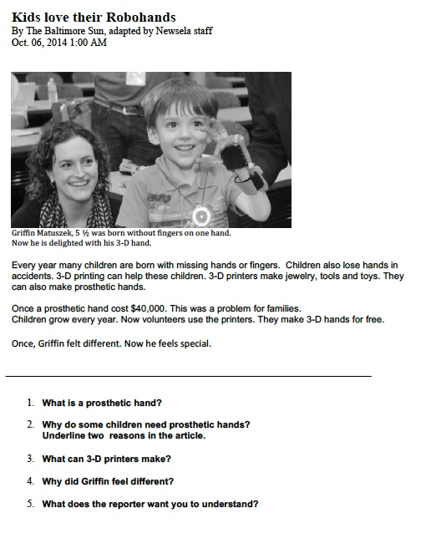
Practice 1: Demonstration Text
p.3

Slide 39
A. Identifying Question Types
What type of question is it?
General Understanding
Key Details
Vocabulary
Inference

Slide 40
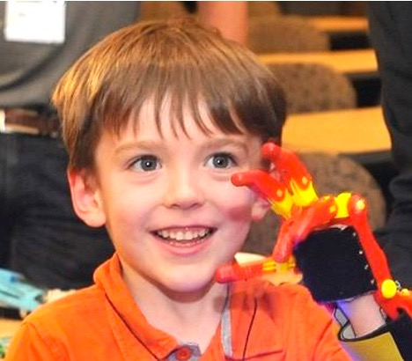
A. Identifying Question Types
• Review each question.
• What type is it?
General Understanding (G) Vocabulary (V)
Key Details (K) Inference (I)
What is a prosthetic hand?
2. Why do some children need prosthetic hands?
Underline two reasons in the article.
What can 3-D printers make?
Why did Griffin feel different?
What does the reporter want you to understand?

Slide 41
B. Analyzing Questions
Is it a text dependent question?
TDQ = Text Dependent Question
NTDQ = Not Text Dependent Question
? = Not sure

Slide 42
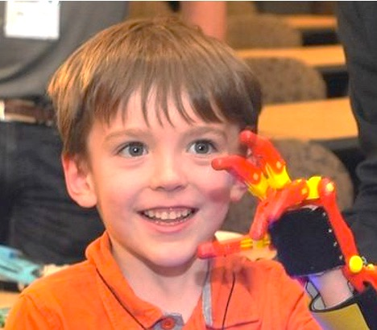
B. Analyzing Questions
• Review each question.
• Mark each question.
TDQ = Text Dependent
NTDQ = Not Text Dependent
? = Not Sure
What is a prosthetic hand?
2. Why do some children need prosthetic hands?
Underline two reasons in the article.
What can 3-D printers make?
Why did Griffin feel different?
What does the reporter want you to understand?
Notes:
Don’t enhance!

Slide 43
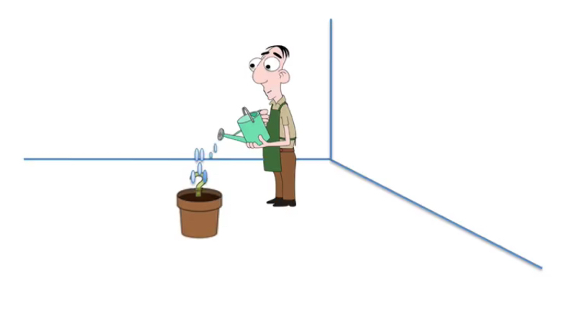
ENHANCING QUESTIONS

Slide 44
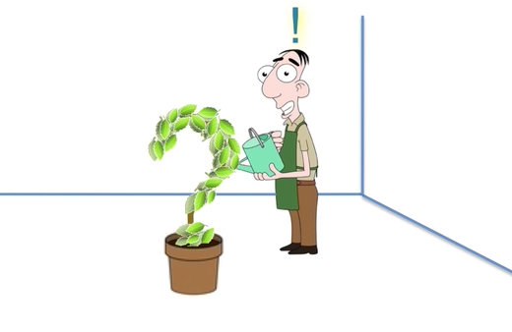
C. Enhancing Questions
Article: Kids Love Their Robohands
Question:
What can 3-D printers make?
Enhanced Question:
According to the article, what can 3-D printers make?

Slide 45
C. Enhancing Questions
Article: Kids Love Their Robohands
Question: What is a prosthetic hand?
Enhanced Question:
Look at the caption. What is another word for a prosthetic hand?

Slide 46
C. Enhancing Questions
Article: Article: Kids Love Their Robohands
Question: Why did Griffin feel different?
Enhanced Question:
Why did Griffin feel different?
Underline the information in the article to support your answer.

Slide 47
TEXTS WE’LL BE WORKING WITH
PAGES 4-9
Notes:
DIRECT THEM TO THIS IN THEIR HANDOUT (P.

Slide 48
SAMPLE TDQ QUESTIONS, STEMS, PROMPTS, AND FRAMES p. 11
 | Beginning | Intermediate/Advanced
MAIN IDEA | Read the ________ text again. | According to the text, what conclusion can you draw about _____________ (idea/concept/ event)?
KEY DETAILS Y D T A I l | Explain ________ (word/idea) in your own words. | Locate the _______ (idea/concept/ event) in paragraph ____.
VOCABULARY | Reread paragraph ___. Circle the (word/phrase) in the ___ sentence. What does the (word/phrase) mean? | What does (word / phrase) mean in this text?

Slide 49
YOUR TURN!
8 min
DONE
Work with your partner:
(a) analyze the type of questions in your article :
general understanding
key detail
vocabulary
inference
(b) identify and mark questions that are NOT text dependent (NTDQ)
(c) enhance at least one NTDQ question.
Use the Stems, Prompts, Questions & Frames Chart
Notes:
Jayme and Lori…this is Slide 50. Do we need a slide after 50 for report back instructions. Not sure..just asking.

Slide 50
YOUR TURN: Enhancing Questions
REPORT BACK
BE SURE TO TELL US….
The level of the text
The NTDQ that you enhanced
We worked on the Low Beginning Text.
The question was_____
We changed it to ______
Notes:
This would be the new slide 51 or I can just be sure to say this… Or I can add it to slide 50 but it is pretty crowded.

Slide 51
CCR Reading Anchor Standard 10
Read and comprehend complex literary and informational texts independently and proficiently.
COMMON CORE BAND | Lexile Framework
A (Beg. Literacy, Low Beg., High Beg.) | UP TO 450
B (Int. Low) | 420-820
C (Int. High) | 740-1000
D (Adv. ) | 1050-1235
Notes:
1 MIN
These are the Lexile measures we used to select the materials you will work with today. Notice how the bands overlap – it’s never supposed to be a precise measure (don’t forget the other key parts – qualitative and professional

Slide 52
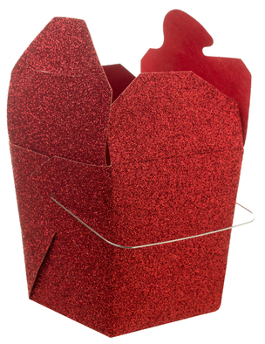
THINK ABOUT IT: WHAT ARE YOU TAKING AWAY?
?
TDQ
http://ccrstdq.pbworks.com

Slide 53
WANT TO TDQ SOME MORE? CHECK OUT THE TDQ WIKI AT
http://ccrstdq.pbworks.com
FOR DIVING IN !

